Slide 1
How DNS Works
Networking & Communication

Slide 2
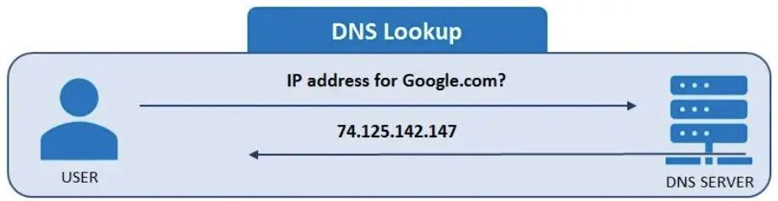
Introduction to DNS
What is DNS?
  The "phonebook of the internet."
  Translates human-readable domain names (e.g., google.com) into IP addresses.
Why is DNS important?
  Enables accessibility of websites.
  Supports distributed, scalable internet architecture.

Slide 3
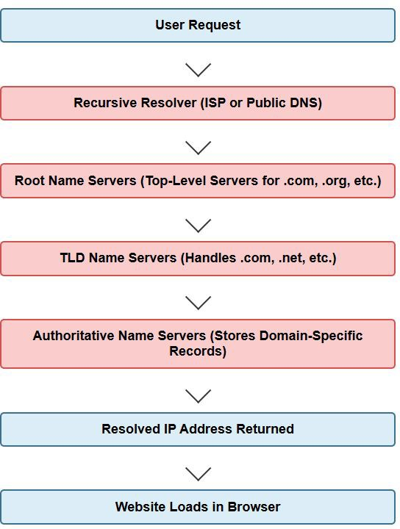
Types of DNS Servers
Root Name Servers: Top-level servers handling .com, .org, etc.
TLD Name Servers: Speciﬁc to domains like .com, .net.
Authoritative Name Servers: Store domain-speciﬁc records.
Recursive Resolvers: Handle queries on behalf of users, contacting multiple DNS servers if necessary.

Slide 4
DNS Caching and Performance Optimization
Why caching matters?
  Reduces latency.
  Reduces load on DNS servers.
Where caching occurs?
  Browser cache (stores previous lookups).
  OS cache (/etc/hosts, Windows DNS cache).
  Recursive Resolver cache (ISP level).
Time-To-Live (TTL): Determines how long a cached record is valid.

Slide 5
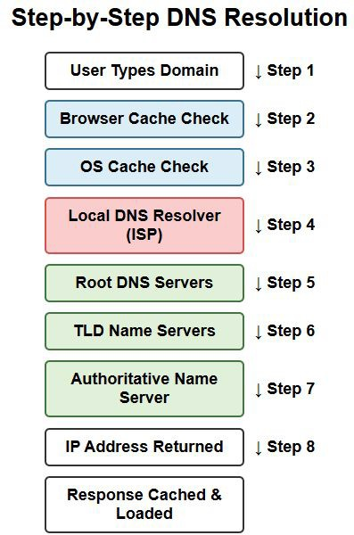
The Domain Name Resolution Process
Step-by-step breakdown of how DNS resolves a domain name:
  User types a domain name in the browser.
  Browser cache check (if the IP is already known).
  Operating System (OS) cache check.
  Query to the Local DNS Resolver (ISP or conﬁgured DNS server).
  If not found, query goes to Root DNS servers.
  TLD (Top-Level Domain) servers provide the Authoritative DNS server details.
  Authoritative DNS server returns the IP
address.
  Response is cached and returned to the user.

Slide 6
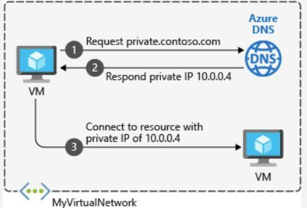
Importance of DNS in Large-Scale Systems
Ensuring High Availability
  Load balancing using DNS.
  Anycast DNS for faster global resolution.
DNS Failover Strategies
  Primary and secondary DNS servers.
Content Delivery Networks (CDNs) & DNS
  How DNS directs users to the nearest CDN node for fast loading.
DNS Security Risks
  DNS poisoning, cache poisoning, and DDoS attacks.

Slide 7
Interview Questions Related to DNS
Explain the DNS resolution process step by step.
What is the diﬀerence between authoritative and recursive DNS servers?
How does DNS caching improve performance? Where does it occur?
What is TTL in DNS, and why is it important?
How does DNS-based load balancing work in large-scale systems?
What are common DNS-related security threats, and how can they be mitigated?

Slide 8
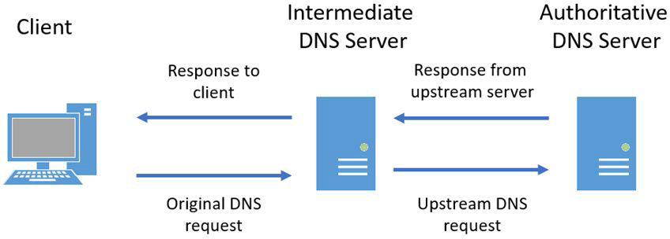
Summary & Takeaways
DNS is critical for internet functionality.
Caching improves eﬃciency and reduces latency.
DNS load balancing & failover are essential for large-scale systems.
Security threats exist, but best practices help mitigate them.
What's Next
  Client-Server Model Explained

